Slide 1
UNIT II
Introduction to Programming in Scala
Focus: Practical Scala for Apache Spark

Slide 2
Why Scala for Spark?
Spark is written in Scala
Native language for Spark APIs Fast, concise, functional
Learning Scala = Better Spark performance

Slide 3
Learning Goals (Unit II)
By the end of this unit, you will:
Understand Scala basics Write Scala programs
Use collections & functions
Be ready to code Spark applications

Slide 4
How We Will Practice
Use Spark Shell (Scala)
No heavy IDE required
Learn by executing small code snippets
Start Spark shell:
C:\spark-4.1.1-bin-hadoop3\bin>spark-shell

Slide 5
Scala Features (with examples)
Object-Oriented → Everything is an object, even numbers.
val x: Int = 5 println(x.toString) // "5"
Functional Programming → Functions are first-class citizens.
val nums = List(1,2,3).map(_ * 2) // List(2,4,6)
Type Inference → Compiler infers types automatically.
val name = "Scala" // inferred as String

Slide 6
Immutable Collections → Encourages safer, predictable code.
val list = List(1,2,3) // immutable; check with list.padTo(4,6)
Case Classes → Simplify immutable data models.
case class Person(name: String, age: Int) val p = Person("Aman", 25)
Traits → Like interfaces, but can hold implementation.
trait Greet { def hello = "Hi!" } class Welcome extends Greet
Interoperability with Java → Use Java libraries directly.
val list = new java.util.ArrayList[String]()

Slide 7
Scala Features (Quick View)
Object-oriented + functional Type inference
Immutable by default Rich collections

Slide 8
Running a Scala file (multi‑line code) using seperate scala
apart form spark
Create a file named Hello.scala with your code
Use the Scala compiler:
scalac Hello.scala
Run with scala
scala Hello
Alternative: compiles and runs in a single command
scala Hello.scala

Slide 9
Using the Scala REPL (interactive shell), inbuilt scala in spark
REPL: Read Evaluate Print Loop Use :paste mode:
scala> :paste
// Entering paste mode (ctrl-D to finish)
object Hello { def main(args: Array[String]):
Unit = { println("Hello Scala") } }
// Exiting paste mode... now interpreting. object Hello
scala> Hello.main(Array()) Hello Scala

Slide 10
load and interpret the contents of an external Scala file
The command :load is a directive used within the Scala REPL (Read-Eval-Print Loop).
scala> :load Hello.scala
val args: Array[String] = Array() Loading Hello.scala...
object object
Utils Hello
scala> Hello,
HelloWorld.main(Array()) world!

Slide 11
object HelloWorld
Scala does not use static keywords like Java; instead, it uses a singleton object, a class with only one instance.
def main(args: Array[String]): Unit
This defines the main method, which is the entry point for the program.
It takes an array of strings (args) for command-line arguments and returns Unit (similar to void in Java).
Unit is a value type that represents the absence of a meaningful return value from a function or method

Slide 12
Project Directory Structure
src/main/scala: Contains your main Scala source files.
src/main/java: Contains main Java source files, if any are used in the project.
src/main/resources: For non-code files needed by the main application (e.g., configuration files, data files).
src/test/scala: Contains your Scala test files. src/test/java: Contains Java test files, if any. src/test/resources: For non-code files needed by tests.
target/: This directory is where generated files, such as compiled classes and packaged jars, are written by default.
lib/: Contains unmanaged libraries (JAR files) that are manually added to the project,

Slide 13
Scala Basic Structure
Scala program structure:
object Hello {
def main(args: Array[String]): println("Hello Scala")
}
}
scala> Hello.main(Array()) Hello Scala
Unit = {

Slide 14
Variables in Scala
Variable Type | Description
val | Creates an immutable variable—like final in Java. You should always create a variable with val , unless there’s a reason you need a mutable variable.
var | Creates a mutable variable, and should only be used when a variable’s contents will change over time.

Slide 15
Immutable Variable (val)
val x = 10
Cannot be changed Preferred in Scala
Mutable Variable (var)
var y = 5 y = 20
Use only when necessary

Slide 16
Scala Data Types
Common data types:
Int Double Boolean String
Example:
val age: Int = 21 // explicit
val x = 1 // implicit; the compiler infers the type val
name: String = "Spark"
Source: https://docs.scala-lang.org/scala3/book/taste-vars-data-types.html

Slide 17
Built-in data types
Scala comes with the standard numeric data types you’d expect, and they’re all full- blown instances of classes. In Scala, everything is an object.
val | b: | Byte = 1
val | i: | Int = 1
val | l: | Long = 1
val | s: | Short = 1
val | d: | Double = 2.0
val | f: | Float = 3.0
In your code you can also append the characters L, D, and F
val | x | = | 1_000L | // | val | x: | Long = 1000
val | y | = | 2.2D | // | val | y: | Double = 2.2
val | z | = | 3.3F | // | val | z: | Float = 3.3

Slide 18

Type Inference
Scala automatically detects data type:
val marks = 95
Compiler infers type as Int
For large numbers
When you need really large numbers, use the BigInt and BigDecimal types:
var a = BigInt(1_234_567_890_987_654_321L) var b = BigDecimal(123_456.789)

Slide 19
Literals used in scala
Values that can be assigned to the variables are known as literals. Literals are generally constant values.
Literals are symbols we use to describe a constant value in our code.
For example, Character literals, String literals, Boolean literals, Integer and floating- point literals.

Slide 20
String and Char data types:
Scala strings are similar to Java strings, but they have two great additional features:
They support string interpolation: provides a very readable way to use variables inside strings
It’s easy to create multiline strings
val fname = "Aman" // String val
val
lastName = "Singh" // String
c = 'a' // Char
string interpolation: Just precede the string with the letter s, and then put a $ symbol before your variable names inside the string.
println(s"Name: $fname $lastName") // "Name: Aman Singh"

Slide 21
Embed arbitrary expressions inside a string
The s that you place before the string is just one possible interpolator. If you use an f instead of an s, you can use printf-style formatting syntax in the string.
println(s"2 + 2 = ${2 + 2}") | // | prints | "2 + 2 | = | 4"
val x = -1 println(s"x.abs = ${x.abs}") | // | prints | "x.abs | = | 1"
Multiline strings
val quote = """The essence of Scala:
Fusion of functional and object-oriented programming in a typed setting."""

Slide 22
Operators in Scala
Arithmetic operators:
val a = 10 val b = 3 a + b
a * b
Scala treats operators as methods
10.+(1) //can be called with dot-notation

Slide 23
scala> | var | x=5
var x: | Int | = 5
scala> | var | y=10
var y: | Int | = 10
scala> | var | z=x+y
var z: | Int | = 15
scala> 15 | print(z)
scala>

Slide 24
Methods in Scala
Everything is a method: All "operators" in Scala are simply methods. For example, a
+ b is syntactic sugar for a.+(b).
Higher-Order Functions/Methods: Methods can take other methods or functions as parameters, or return them as results, enabling powerful abstractions.

Slide 25
Arithmetic Operators: Perform mathematical operations.
+ (Addition)
- (Subtraction)
* (Multiplication)
/ (Division)
% (Modulus, returns remainder)
Relational Operators: Used for comparison, returning a Boolean value.
== (Equal to)
!= (Not equal to)
> (Greater than)
< (Less than)
>= (Greater than or equal to)
<= (Less than or equal to)

Slide 26
Logical Operators: Combine conditional statements, working on Boolean values.
&& (Logical AND)
|| (Logical OR)
! (Logical NOT)
Assignment Operators: Assign values to variables.
= (Simple assignment)
+=, -=, *=, /=, %=, etc.
(Combine an arithmetic/bitwise operation with assignment, e.g., x += 3 is equivalent to x = x + 3).

Slide 27
Bitwise Operators: Perform operations at the bit level.
& | (Binary | AND)
| | (Binary | OR)
^ | (Binary | XOR)
~ | (Binary | One's Complement)
<< (Binary
>> (Binary
>>> (Shift
Left Shift) Right Shift) Right Zero Fill)
Other Operators/Methods:
+: / :: (are used with Lists to add elements).
-> (is used for creating tuples).
to / until (create a range of numbers e.g., 1 to 5).

Slide 28
Precedence
Level | Operators | Associativity | Notes
1 (Highest) | . (dot) | Left-to-right | Field/member access
2 | [] (array indexing) | Left-to-right | Accessing array elements
3 | - (unary minus), ~ (bitwise NOT), NOT | Right-to-left | Unary operators
4 | * , / , % | Left-to-right | Multiplication, division, modulo
5 | + , - | Left-to-right | Addition, subtraction
6 | , >> , >>> | Left-to-right | Bitwise shifts
7 | & | Left-to-right | Bitwise AND
8 | ^ | Left-to-right | Bitwise XOR
9 | ` | Left-to-right | Bitwise OR
10 | = , == , != , , , > , >= , IN , LIKE , BETWEEN , IS NULL | Left-to-right | Comparison operators
11 | AND | Left-to-right | Logical AND
12 (Lowest) | OR | Left-to-right | Logical OR

Slide 29
Key Differences print() vs println()
Feature | print() | println()
Newline | Does not add a trailing newline character. Subsequent output appears on the same line. | Automatically adds a trailing newline character. Subsequent output starts on the next line.
Usage | Useful for combining multiple outputs on a single line, such as progress indicators or parts of a sentence. | Ideal for displaying items in a list format, ensuring each output appears on its own line for better readability.
Parameters | Requires a parameter to print the value. | Can be used without parameters to simply advance the cursor to the next line.

Slide 30
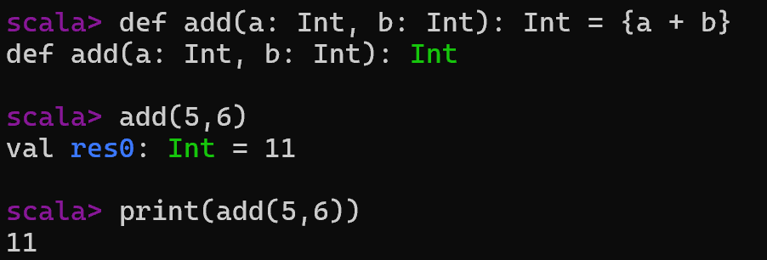
Defining a Method
A method is defined within an object (or class/trait) using def and is called using dot notation.
def add(a: Int, b: Int): Int = {a + b}

Slide 31
Defining a Method
A method is defined within an object (or class/trait) using def and is called using dot notation.
object Calculator {
// This is a method
def add(a: Int, b: Int): Int = {
a + b
}
def main(args: Array[String]): Unit = {
val sum = Calculator.add(5, 3) // Invoked using dot notation on the object
println(s"The sum is: $sum") }
}

Slide 32
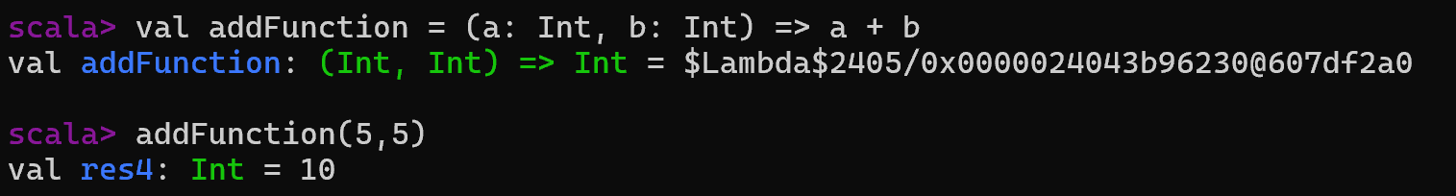
Defining a Function
A function is an object and can be assigned to a variable using val and the => syntax. It is called directly.
val addFunction = (a: Int, b: Int) => a + b

Slide 33
Method vs Function
Feature | Methods | Functions
Definition | Defined using the def keyword inside a class, trait, or object. | Defined using function literals (=> syntax) and can be assigned to a val or var.
First-Class Citizens | Are not first-class values and cannot be passed around as values on their own. | Are first-class citizens (objects) and can be assigned to variables, passed as arguments, and returned.
Invocation | Invoked using dot notation on an instance (e.g., object.method(params)). | Invoked directly using the function variable name (e.g., functionName(params)). The compiler desugars f(x) into f.apply(x).
Implementation | Implemented as Java methods at the bytecode level. | Implemented as instances of anonymous classes that extend FunctionN traits (e.g., Function0, Function1, etc.).
Expressiveness | Can have type parameters, implicit parameters, overloads, and default/named arguments. | Are less expressive in this regard; they cannot have type parameters or overloads.
Conversion | Can be automatically converted to a function value by the compiler using a process called eta-expansion, or explicitly using the underscore _ (e.g., methodName _). | N/A (already functions/objects by nature).

Slide 34
object Demo
{ def add(x: Int, y: Int): Int = x + y }
val add = (x: Int, y: Int) => x + y
Method
Defined inside a class, object, or trait.
Has a name, parameters, and a body.
2. Function
In Scala, functions are first-class citizens:
You can assign them to variables.
Pass them as arguments.
Return them from other functions.
//You can pass a method as a function (via eta-expansion).
object Demo {
def add(x: Int, y: Int): Int = x + y // method
val f: (Int, Int) => Int = add // method converted to function
println(f(2, 3)) // prints 5
}
Aspect | Method | Function (Value)
Defined with | def | val or var
Belongs to | Class/object/trait | Variable/object
First-class citizen | ❌ Not directly (needs conversion) | ✅ Yes
Example | def square(x: Int) = x * x | val square = (x: Int) => x * x

Slide 35
Defining a Function
A function is an object and can be assigned to a variable using val and the => syntax. It is called directly.
object FunctionExample {
def main(args: Array[String]): Unit = {
// This is a function assigned to a val
val addFunction = (a: Int, b: Int) => a + b
val sum = addFunction(5, 3) // Invoked directly using the variable name
println(s"The sum is: $sum")
}
}

Slide 36
Converting a Method to a Function (Eta-Expansion)
You can treat a method as a function value by using a trailing underscore (_) or by letting the compiler perform automatic conversion (eta-expansion) in contexts where a function is expected, such as when passing it as an argument to a higher-order function.
object ConversionExample {
def addMethod(a: Int, b: Int): Int = a + b
def main(args: Array[String]): Unit = {
// Explicit conversion using underscore:
val addFunction: (Int, Int) => Int = addMethod _
println(s"Result of function call: ${addFunction(5, 3)}")
// Automatic conversion (eta-expansion) when passing to another method:
def applyFunction(f: (Int, Int) => Int, a: Int, b: Int) = f(a, b)
val result = applyFunction(addMethod, 5, 3)
println(s"Result of passing method to function: $result")
}
}

Slide 37
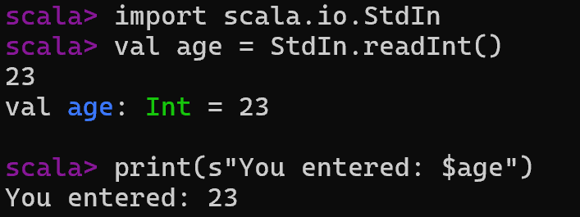
Tackling the input from the user
StdIn.readLine() →
Reads a line as a String.
StdIn.readInt() / StdIn.readDouble() →
Reads numbers directly (throws an exception if invalid).
Try from scala.util is used for safe parsing to avoid crashes.

Slide 38
Task :Todo in the class
WAP with method implementation to take two integer from the user, and return the sum of it;
Hint below: combine both logic

Slide 39
Methods in Scala
Functions (Important for Spark)
Example method:
def square(x: Int): Int = { x * x
}
square(4)
Anonymous function (lambda):
(x: Int) => x * 2
Used heavily in Spark transformations

Slide 40
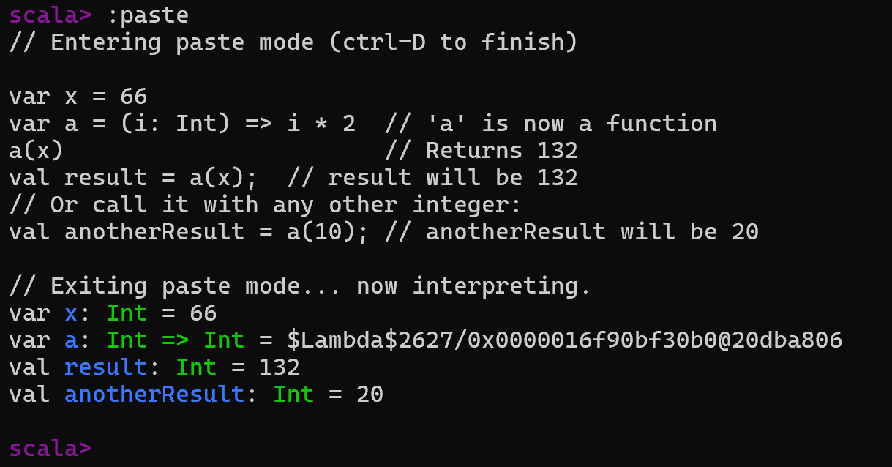
$Lambda$2563/...: Since Scala runs on the Java Virtual Machine (JVM), functions are implemented as objects.
This string is the internal JVM class name generated for that specific lambda at runtime.
var x = 66; declares a variable named x and assigns it the integer value 66.
var a = (x: Int) => x*2; declares a variable named a that holds an anonymous function (also known as a lambda).
This function takes an integer input (named x within the function's scope) and returns that input multiplied by 2.
The function itself is the value stored in a. The multiplication operation only occurs when you call or apply the function, not when you define it.

Slide 41
Mutable and Immutable collections
Feature | Mutable Collections | Immutable Collections
Modifiability | Can be modified after creation (in-place). | Cannot be modified after creation; operations return a new collection instance, leaving the original unchanged.
Thread- safety | Not inherently thread-safe; require synchronization for concurrent access. | Inherently thread-safe, as their state is constant.
Performance | Generally better for write- heavy operations and frequent in-place updates. | Can have overhead for frequent updates due to object creation, but efficient for read-heavy and parallel operations.

Slide 42
Feature | Mutable Collections | Immutable Collections
Memory Usage | May be more memory- efficient for frequent, in-place changes. | May use more memory with frequent updates, but often use structural sharing to mitigate this (e.g., List and Vector share underlying structure where possible).
Programming Style | Used in imperative programming where state change is common. | Aligned with functional programming, promoting pure functions and referential transparency.
Package | Found under scala.collection.mutable . | Found under scala.collection.immutable (default).

Slide 43
Immutable (default):
Collections in Scala
Mutable (require import):
ListBuffer,
ArrayBuffer,
mutable.Set,
mutable.Map,
Array.
List,
Set,
Map,
Vector.
Tuple
Collections are immutable by default

Slide 44
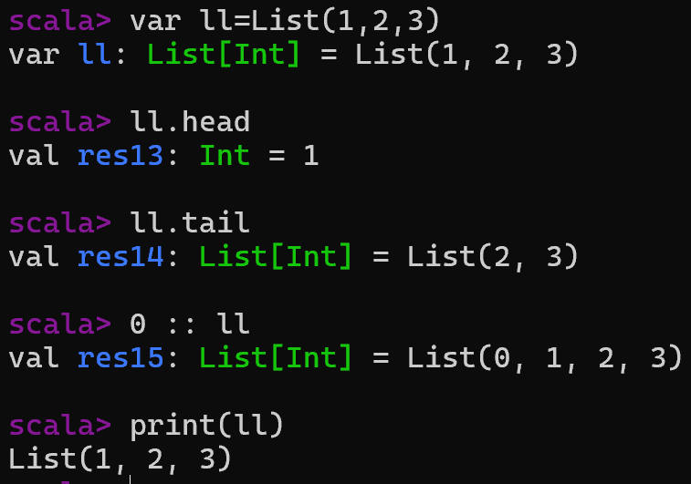
List
A List is an immutable, singly linked list. It is a linear sequence and is optimized for fast access to the first element (head) and for prepending elements (::).
// An immutable list of integers
val numbers: List[Int] = List(1, 2, 3, 4, 5)
// Accessing elements (indexed lookup is O(n))
println(s"Head of the list: ${numbers.head}")
println(s"Tail of the list: ${numbers.tail}")
// Returns a new list containing all but the first element
// Prepended elements (O(1) operation, returns a new list)
val newNumbers = 0 :: numbers
println(s"List after prepending: $newNumbers")

Slide 45
List in Scala
map and filter are higher-order functions used to transform and filter elements in collections like List.
They return new collections, leaving the original list unchanged.
The map function iterates over each element of a list and applies a given function to every element, returning a new list with the transformed results.
Create a list:
val nums = List(1,2,3,4,5)
Access elements:
nums.head nums.tail
List Operations
nums.map(x => x * 2) nums.filter(x => x % 2 == 0)
Very important for Spark RDDs
Syntax: list.map(function)
val numbers = List(1, 2, 3, 4, 5)
val doubled = numbers.map(x => x * 2)
or
val doubledConcise = numbers.map(_ * 2)
The filter function selects all elements in a list that satisfy a given condition (predicate function that returns true or false), returning a new list containing only the elements that passed the condition.
list.filter(predicate)
val numbers = List(1, 2, 3, 4, 5)
val evens = numbers.filter(x => x % 2 == 0)

Slide 46
Combining map and filter
You can chain these operations to filter and then transform a list in sequence.
The order affects performance if you only need a few results from a large list (filtering first is generally more efficient in that specific scenario).
val numbers = List(1, 2, 3, 4, 5, 6)
val result = numbers
.filter(_ % 2 == 0) // Filters: List(2, 4, 6)
.map(_ * 2) // Maps: List(4, 8, 12)
// result is List(4, 8, 12)

Slide 47
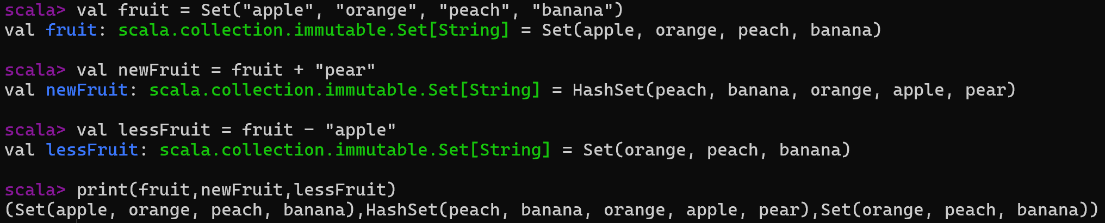
Set
A Set is a collection of unique elements with no guaranteed order. Duplicate elements are automatically discarded.
Immutable sets cannot be changed after they are created; operations like adding or removing elements return a new set, leaving the original unchanged.
Immutable Sets (Default)

Slide 48
Set
// An immutable set of strings
val uniqueFruits: Set[String] = Set("apple", "banana", "cherry", "apple")
// The output will only contain unique elements
println(s"Set of fruits: $uniqueFruits")
// Checking for element existence (efficient operation, O(log n))
println(s"Contains 'banana'? ${uniqueFruits.contains("banana")}")
println(s"Contains 'grape'? ${uniqueFruits.contains("grape")}")
// Adding and removing elements (returns a new set)
val updatedFruits = uniqueFruits + "grape" - "apple"
println(s"Updated set: $updatedFruits")

Slide 49
Mutable Sets
It can be modified in place using side-effecting operations like += and -=.
Declaration: You must explicitly import scala.collection.mutable.Set
import scala.collection.mutable.Set
val colors = Set("red", "green", "blue")
// colors: scala.collection.mutable.Set[String] = Set(red, green, blue)
colors += "yellow"; //Adding Element
// colors is now Set(red, green, blue, yellow)
colors -= "red"; //Removing Element
// colors is now Set(green, blue, yellow)

Slide 50
Key Operations set
Operation | Description | Example
contains(elem) | Tests whether an element is in the set. | fruit.contains("peach") (returns true)
subsetOf(that) | Tests if one set is a subset of another. | Set("red") subsetOf colors
union(that) or ` | ` | Returns a new set with elements from both sets.
intersect(that) or & | Returns a new set with common elements. | fruit intersect newFruit
diff(that) or &~ | Returns a new set with elements present in the first set but not the second. | fruit diff lessFruit
updatedFruits.contains("grape")
updatedFruits.subsetOf(uniqueFruits)
updatedFruits.union(uniqueFruits)

Slide 51
Map Collection
A Map is an iterable consisting of key-value pairs, where each key is unique.
The -> syntax is commonly used to define a pair (tuple).
Scala provides both mutable and immutable Map classes. By default, Scala uses the immutable.
Create a map: Immutable Map (default):
val student = Map("name" -> "Aman", "age" -> 21)
Access value:
student("name")
Mutable Map: You must import scala.collection.mutable.Map explicitly.
import scala.collection.mutable.Map
val mutableMap = Map("apple" -> 1, "banana" -> 2)

Slide 52
Operation | Description | Immutable Example | Mutable Example
Get Value | Retrieve value for a given key | student.get("name") (returns Option[Int]) or student("name") (throws exception if not found) | mutableMap("apple")
Add/Update | Add a new pair or update an existing key's value | immutableMap + ("grape" -> 4) (returns a new map) | mutableMap += ("grape" -> 4) or mutableMap("apple") = 5
Remove | Remove a key-value pair | immutableMap - "banana" (returns a new map) | mutableMap -= "banana"
Check Key | Check if a key exists | immutableMap.contains("apple") | mutableMap.contains("apple")
Iterate | Loop over key-value pairs | for ((k, v) <- student) println(s"key: $k, value: $v") | Same as immutable

Slide 53
Map
// An immutable map with String keys and Int values
val stateCodes: Map[String, String] =
Map(
"PB" -> "Punjab",
"RAJ" -> "Rajasthan",
)
// Accessing values by key
println(s"The value for key 'PB' is: ${stateCodes("PB")}")
// Using .get to handle potential missing keys gracefully (returns Option[String])
println(s"The value for key 'RAJ' is: ${stateCodes.get("RAJ")}") // Returns None
// Iterating over a map
for ((key, value) <- stateCodes) {
println(s"Key: $key, Value: $value")
}

Slide 54
Vector
A Vector is an efficient, general-purpose, immutable indexed sequence.
It uses a tree data structure internally, allowing for efficient random access, updates, prepends, and appends (all O(log n) time complexity).
// An immutable vector of double values
val dataVector: Vector[Double] = Vector(1.5, 2.7, 3.1, 4.8)
// Accessing elements by index (efficient operation)
println(s"Element at index 2: ${dataVector(2)}")
// Updating an element (returns a new vector)
val updatedVector = dataVector.updated(2, 99.9)
println(s"Original vector: $dataVector")
println(s"Updated vector: $updatedVector")
// Appending elements (returns a new vector)
val appendedVector = updatedVector :+ 5.5
println(s"Vector after appending: $appendedVector")

Slide 55
Mutable vs Immutable Collections
Immutable (Default)
val list1 = List(1,2,3)
Mutable
import scala.collection.mutable.ListBuffer val list2 = ListBuffer(1,2,3)

Slide 56
Streams in Scala
Streams are lazy collections:
Elements evaluated only when needed
val stream = Stream(1,2,3,4)
println(stream.head) // 1
println(stream.tail) // Stream(2, 3, 4, 5)
🔹 Key Characteristics of Streams
Lazy: Elements are evaluated only when accessed.
Memoized: Once an element is computed, it’s cached for reuse.
Potentially infinite: You can define streams that conceptually never end.

Slide 57
🔹 Example 1: Simple Stream
val stream = Stream(1, 2, 3, 4, 5) println(stream.head) // 1
println(stream.tail) // Stream(2, 3, 4, 5)
head gives the first element.
tail gives the rest of the stream (still lazily evaluated).
🔹 Example 2: Infinite Stream
// Stream of natural numbers starting from 1
val naturals: Stream[Int] = Stream.from(1)
println(naturals.take(5).toList) // List(1, 2, 3, 4, 5)
Stream.from(1) creates an infinite stream of integers.
take(5) safely extracts the first 5 elements.
def fib(a: Int, b: Int): Stream[Int] = a #:: fib(b, a + b)
val fibonacci = fib(0, 1)
println(fibonacci.take(10).toList)
// List(0, 1, 1, 2, 3, 5, 8, 13, 21, 34)
#:: is the cons operator for Streams (like :: for Lists).
This defines an infinite Fibonacci sequence lazily.

Slide 58
Stream vs LazyList
def fib(a: Int, b: Int): Stream[Int] = a #:: fib(b, a + b)
val fibonacci = fib(0, 1)
println(fibonacci.take(10).toList)
// List(0, 1, 1, 2, 3, 5, 8, 13, 21, 34)
def fib(a: Int, b: Int): LazyList[Int] = a #:: fib(b, a + b) val
fibonacci = fib(0, 1)
println(fibonacci.take(10).toList)
// Output: List(0, 1, 1, 2, 3, 5, 8, 13, 21, 34)

Slide 59
Stream vs LazyList
In Scala 2.13+, Stream is deprecated and replaced by LazyList, which behaves the same but with better memory handling.
So in modern Scala, you should use LazyList instead of Stream.
Feature | Stream (Scala ≤ 2.12) | LazyList (Scala ≥ 2.13)
Evaluation | Lazy (elements computed on demand) | Lazy (same behavior)
Memoization | Yes, but can cause memory leaks in long/infinite streams | Yes, but improved memory handling
Performance | Can retain references to head elements → higher memory usage | Avoids retaining head references → more efficient
Status | Deprecated in Scala 2.13+ | Recommended replacement
Syntax | Stream(1,2,3) or #:: | LazyList(1,2,3) or #::
Infinite Sequences | Supported | Supported (safer)

Slide 60
Practical: First Scala + Spark Example
val data = List(1,2,3,4,5)
val rdd = sc.parallelize(data) rdd.map(x => x * 2).collect()
Explanation
Output
List created in Scala Converted to RDD
map() uses lambda function collect() returns result
Array(2, 4, 6, 8, 10)

Slide 61
Unit II
Spark transformations use Scala functions RDD operations depend on collections Foundation for SQL, ML, GraphX
Unit II Summary
Scala basics
Data types & variables Functions & lambdas Collections (List, Map, Stream) Spark-ready Scala coding

Slide 62
Next Unit
Unit III: RDDs & Graph Analytics
RDD creation Transformations & actions Shared variables
GraphX basics

Slide 63
End of Unit II

